Slide 1
AMERICAN INTERNATIONAL UNIVERSITY BANGLADESH
FACULTY OF ENGINEERING COURSE: MICROPROCESSOR AND EMBEDDED SYSTEMS COURSE INSTRUCTOR: NADIA NOWSHIN
Group: 5 Section: C

Slide 2
Presented by
SL. | Name | ID | Program
40 | Raisa Tabassum Tasin | 18-37941-2 | EEE
22 | Kabir, Kazi Shahadat | 18-36341-1 | EEE
25 | Jahan, Nushrat | 18-36586-1 | CSE
37 | Ratul, S.M. Zobaeir Akando | 18-37880-2 | EEE
32 | Nabil, Md. Abdullah | 18-37807-2 | EEE
46 | Prince, Ahmed Tamim Zabir | 18-37382-1 | EEE
36 | Raza, Kala | 18-37869-2 | EEE
34 | Tahrim, H M | 18-37826-2 | EEE
38 | Rafat, Sadman Sakib | 18-37887-2 | EEE

Slide 3
Presentation topic:
Fire Fighting Robot

Slide 4
Introduction
Aims to develop microcontroller based firefighting robot
Sense fire, smoke and temperature at the site of disaster by using flame and smoke sensors mounted on the robot
Robots decrease the need for firefighters to get into dangerous situations
Reduces the load for fire fighters
The robot can function by itself
The vehicles can reach positions that firefighters cannot, such as petrochemical complexes and he warehouses fire

Slide 5
Component list of the Project
Equipment | Quantity
Arduino Uno | 1
Flame Sensor | 3
Gas Sensor | 1
Buzzer | 1
DC Motor | 2
Servo Motor | 1
L293D | 1
Dc Pump | 1
Logic State Switch | 4
Contents
Performance
Contents
Performance
Contents
Performance

Slide 6
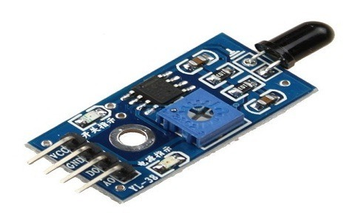
Flame Sensor
A flame detector is a sensor designed to detect and respond to the presence of a flame or fire.
This sensor/detector can be built with an electronic circuit using a receiver like electromagnetic radiation. This sensor uses the infrared flame flash method, which allows the sensor to work through a coating of oil, dust, water vapor, otherwise ice.
Flame Sensor Module: The pin configuration of this sensor is shown below. It includes four pins which include the following. When this module works with a microcontroller unit then the pins are
Pin1 (VCC pin): Voltage supply rages from 3.3V to 5.3V
Pin2 (GND): This is a ground pin
Pin3 (AOUT): This is an analog output pin (MCU.IO)
Pin4 (DOUT): This is a digital output pin (MCU.IO)

Slide 7
Gas Sensor
MQ2 gas sensor is an electronic sensor used for sensing the concentration of gases in the air such as LPG, propane, methane, hydrogen, alcohol, smoke and carbon monoxide.
It is commonly an unwanted by-product of fires.
Smoke Detectors are very useful in detecting smoke or fire (GAS) in buildings, and so are the important safety parameters.
The smoke sensor detects smoke and provides output to the MCU.

Slide 8
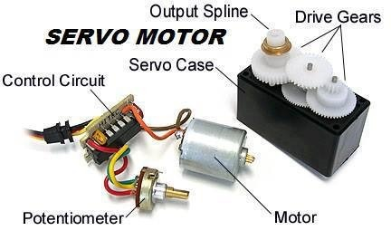
Servomotors
A servo is a small device which has an output shaft which positions on coded signal. It is a rotary or linear actuator that allows for precise control of angular or linear position, velocity and acceleration.
The servo motor is which respond to signal abruptly and accelerate the load quickly are called servo motor.
Buzzer
It is an electronic used to give alarm sound as it is programmed

Slide 9
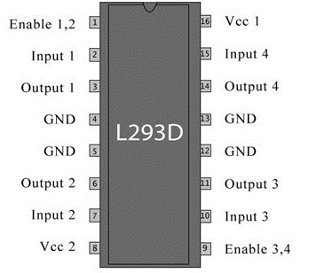
L293D
Pin description of L293D
L293D is a Motor driver integrated circuit which is used to drive DC motors rotating in either direction.
It is a 16-pin IC which can control a set of two DC motors simultaneously. It means that we can control two DC motor with a single L293D IC.
Dual H-bridge Motor Driver integrated circuit(IC). The L293D uses 5V for its own power and external power source is needed to drive the motors, which can be up to 36V and draw up to 600mA.

Slide 10
WATER PUMP
Used to pump water when an abnormal condition arises in the system.
When excess temperature, smoke and flame detected, the water pump starts pumping water.
Water pump is connected to the relay, the relay becomes energizes according to the instruction from the MCU

Slide 11
Block Diagram
Flame Sensor Left
Power Supply (12V)
ARDUINO
UNO
Left Motor
Flame Sensor Forward
L293D Motor Driver
Right Motor
Flame Sensor Right
Servo Motor
Pump Water
Gas Sensor
Buzzer
Power Supply

Slide 12
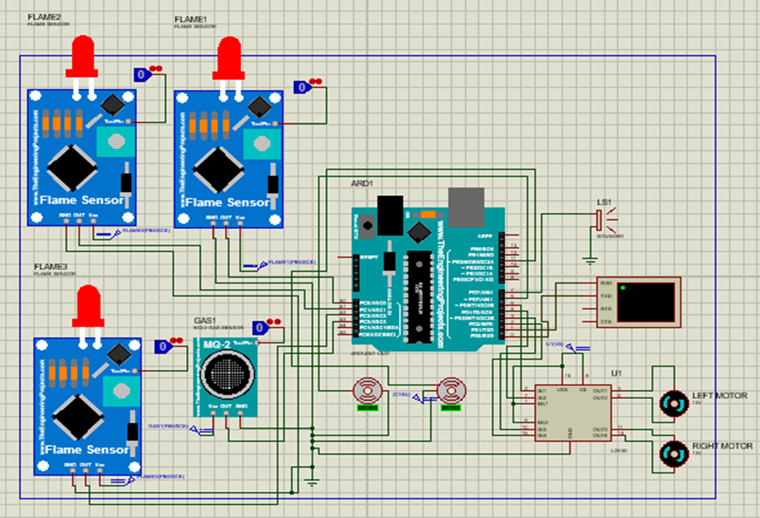
Software Implementation

Slide 13
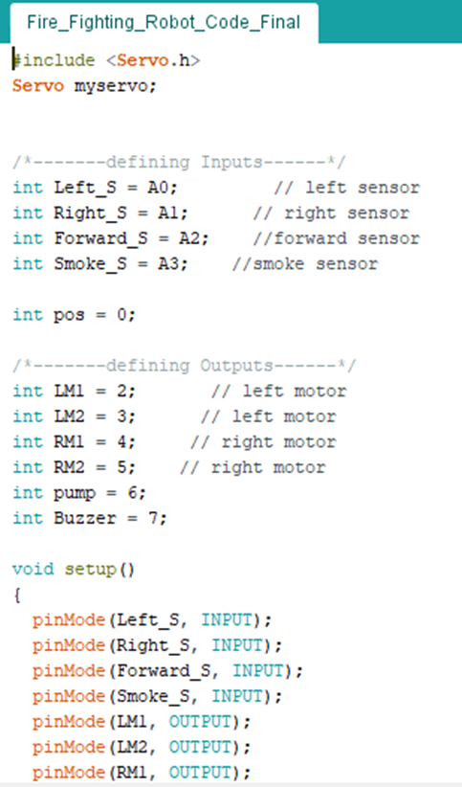
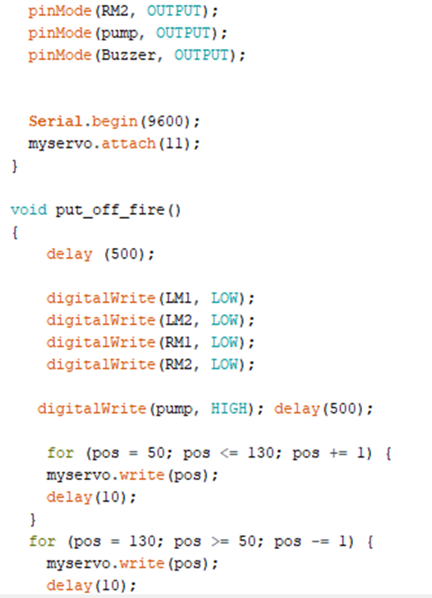
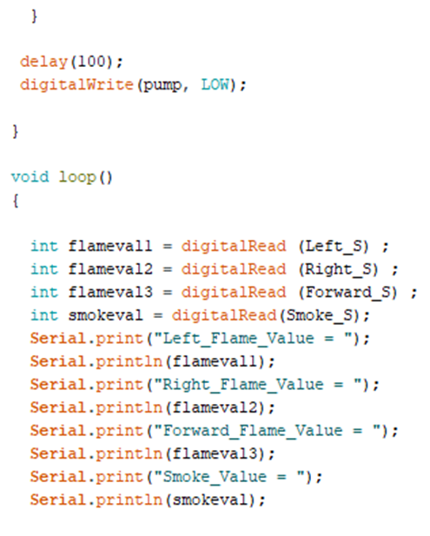

Simulation Codes

Slide 14
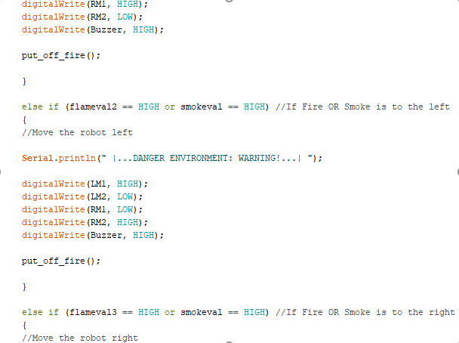
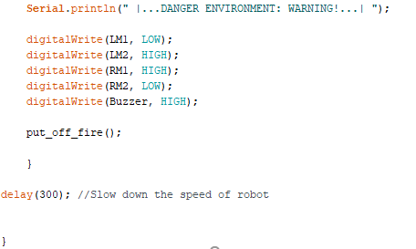
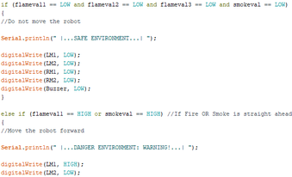
Simulation Codes

Slide 15
Result And Discussion
In this project, an autonomous Firefighting Robot has been implemented which is capable of detecting flames & smokes and extinguishing them successfully.
This robot can move forward, move left & right flawlessly. The motors and Arduino code work together to control the movement of the robot.
If any of the flame sensors or smoke sensor are triggered, then buzzer will start to buzz & warning about the danger environment will be displayed on the Virtual Terminal & safe environment will be shown in case of no such detection.
The motor will start to rotate & move the robot to the danger point upon receiving a signal about the danger environment & start to pump the water with the help of servo motor.
This process will be continued until the fire or smoke has been extinguished completely. Then it will display about the safe environment.

Slide 16
Advantages
To detect the exact direction of the fire source.
Capability of sensing accurately with increased flexibility.
Reduce human effort.
Reliable and economical.
Not sensitive to weather conditions.

Slide 17
Disadvantages
No remote control for the robotic movement.
This autonomous firefighting robot can't move to backward direction.
Our system used only for less than 3.5Kg application.
It is not used to put out large fires.
High Cost

Slide 18
Impact of the project on the society
Safety purpose
This kind of robot can go anywhere easily
Time consuming robot
Fast than Human
Need no employment

Slide 19
Future work
Future work can include the transformation of the experimental robot prototype into a practical robot, which requires improvement in its overall performance.
Face detection system are developed for a fire fighting robot to rescue human beings caught in fire.
The ultrasonic sensor can also be attached to detect any object around the robot to avoid any collision with other objects.
wireless remote control idea can be introduced to this system so that human can control the mechanism of the robot by their own needs.
Using wireless higher Resolution zooming Camera.

Slide 20
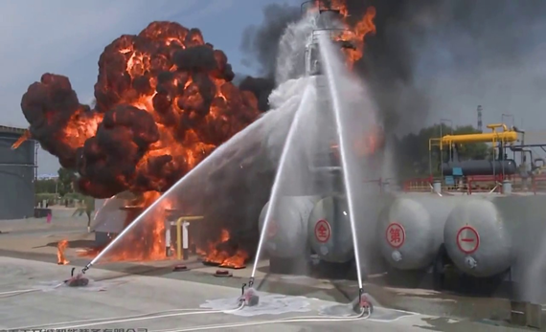
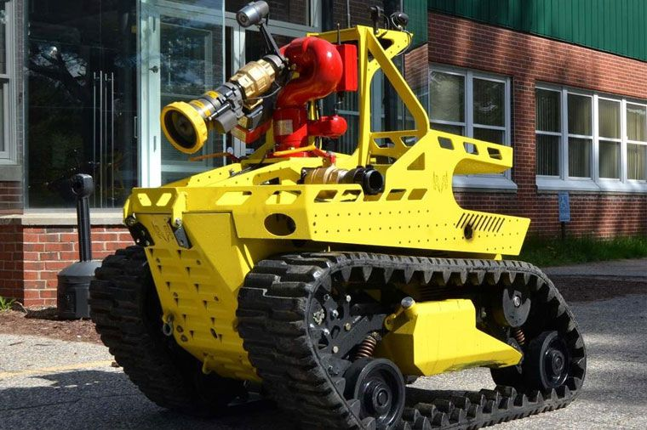
Conclusion
Help fireman in their responsibilities
Detects smoke and flame of fire
Reduce the danger of injury
Require less space to implement
Decrease monetary losses
Reliable and economical
It is used to solve the problem of the fire extinguisher.
It work there , where human beings are not able to reached

Slide 21
Thank you

